Slide 1
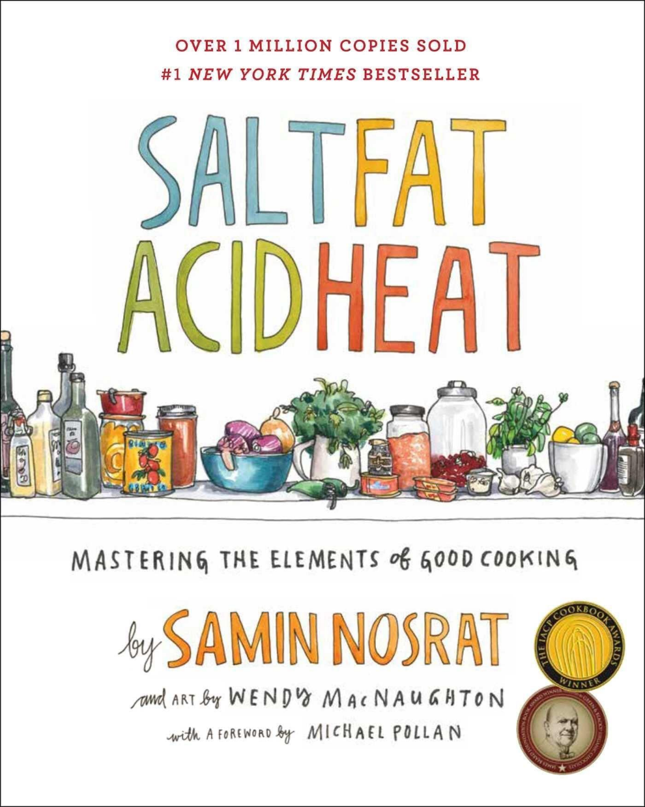
Bioinformatics
Like cooking, but with data!
Yi Jin LIEW | 22 Jul 2022

Slide 2
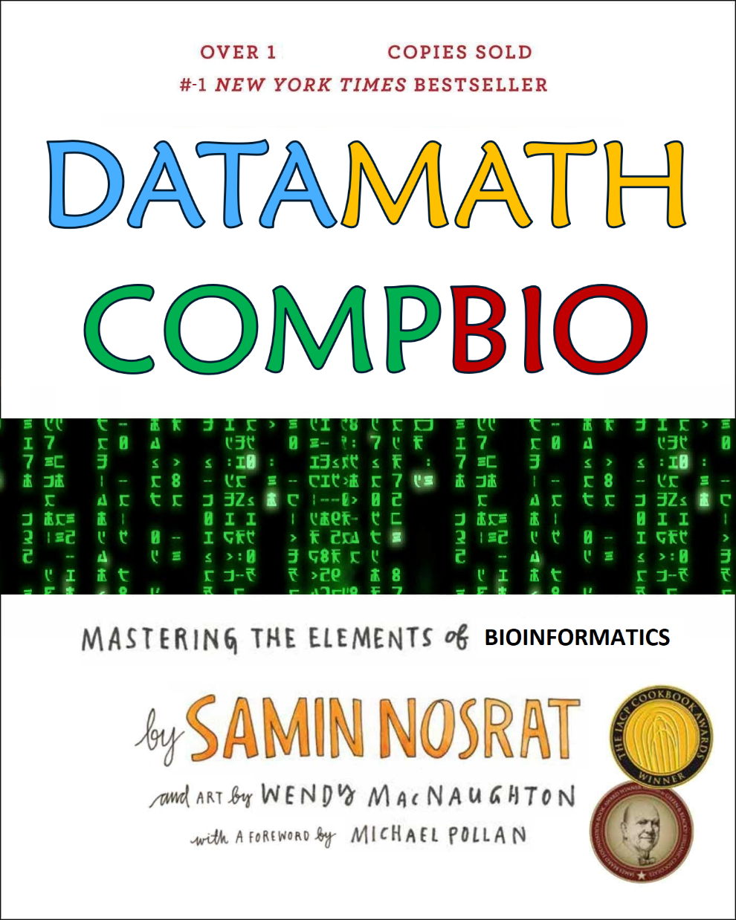
Bioinformatics
Like cooking, but with data!
Yi Jin LIEW | 22 Jul 2022

Slide 3

STARTER
My journey
MAIN
Data
Comp
Math
Bio
DESSERT
Questions/Demo/Freestyle

Slide 4
Starter
My bioinformatics journey

Slide 5
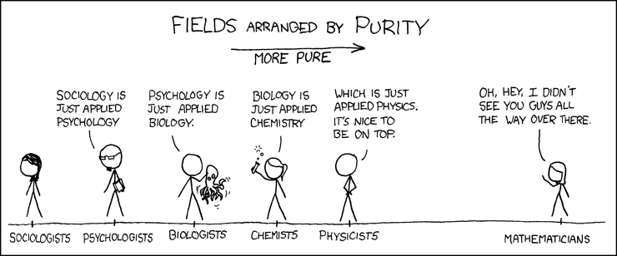
High school: Singapore

Slide 6

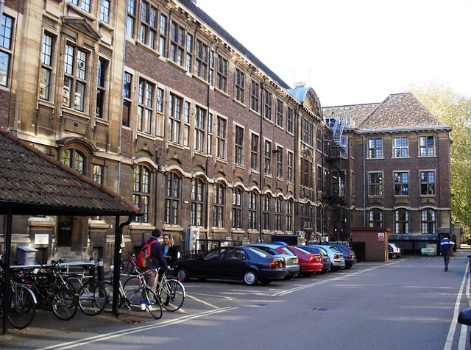


Uni: University of Cambridge (UK)
Undergrad: Natural Sciences (Genetics)
PhD: Genetics

Slide 7
PhD? What’s that?
A 3+ year training course to “git gud” in doing science
Pros
Ask exciting scientific questions
Make reasonable assumptions
Design experiments to answer those questions
Learn new lab techniques, new ways to look at data
CHANGE THE WORLD, YO
Cons
Can be hard to enter (usually need Bachelor’s + honours)
Min 3 years, max...
Usually encouraged to go abroad for new perspectives
You don’t end up earning more $ (really)
Deal with routine failure

Slide 8
Academia, i.e. how to upgrade “Dr.” to “Prof.”
Postgrad (Masters / PhD)
Undergrad (Bachelor’s)
Prof
Junior prof
Postdoc

Slide 9

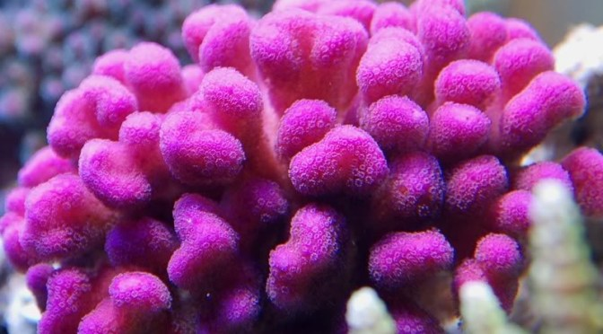
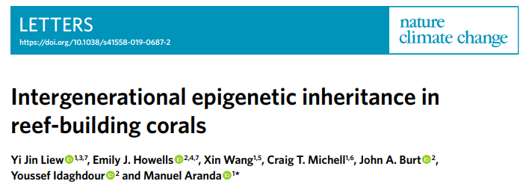
Postdoc: King Abdullah Univ of Sci and Tech (KSA)

Slide 10
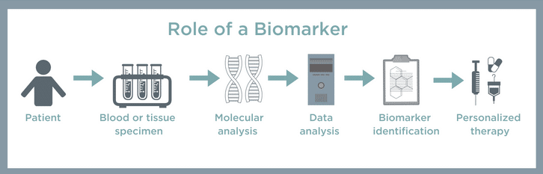
Research Scientist: CSIRO
I am a bioinformatician discovering biomarkers for disease (Molecular Diagnostics group within Human Health program)

Slide 11
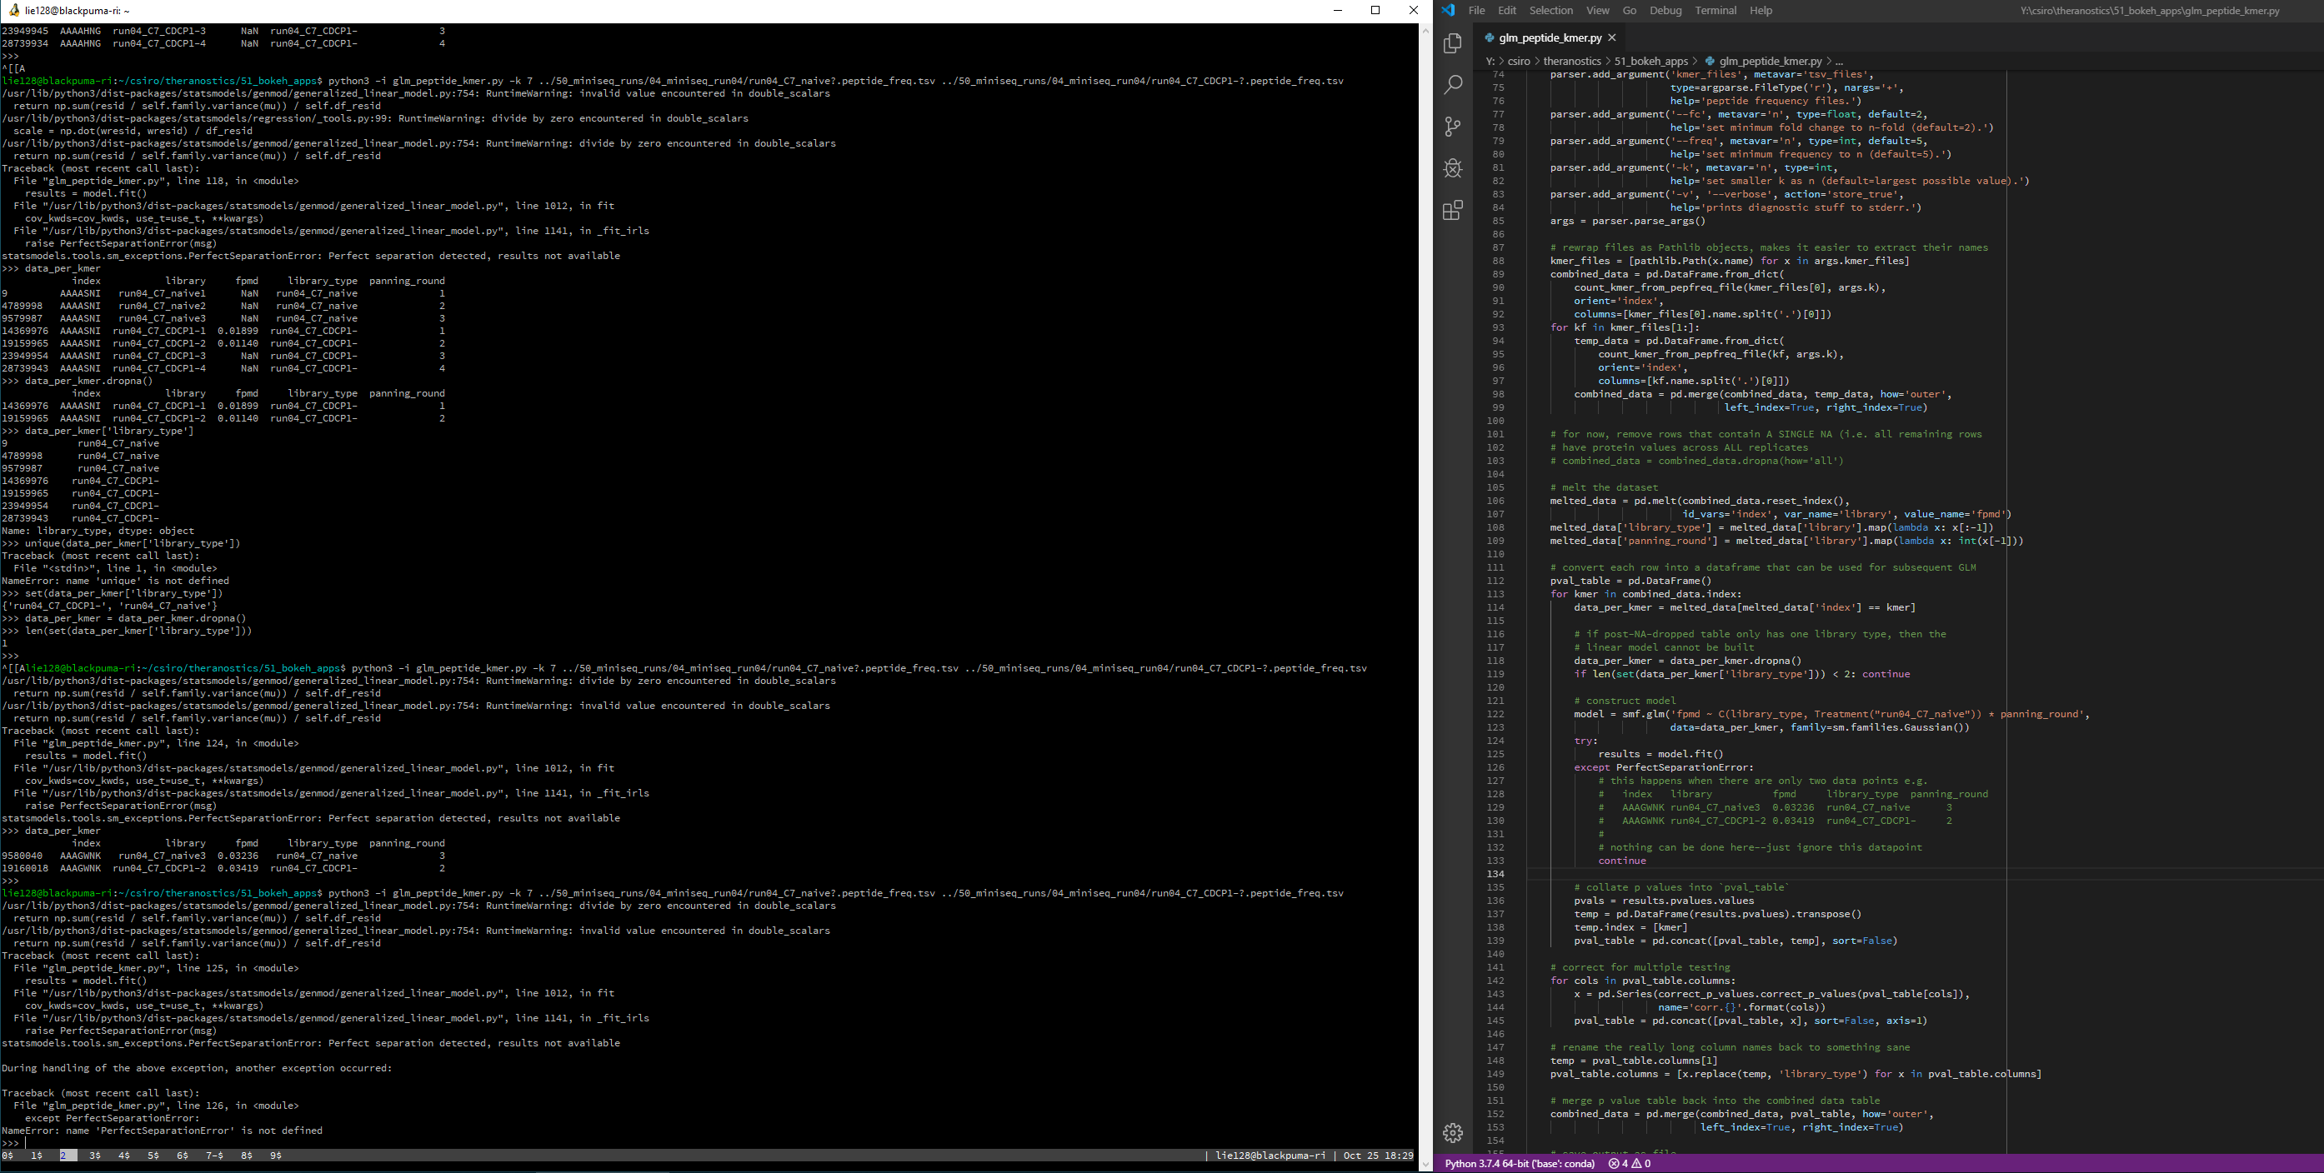
My day-to-day stuff
I write code (after staring at the screen for a long time)

Slide 12
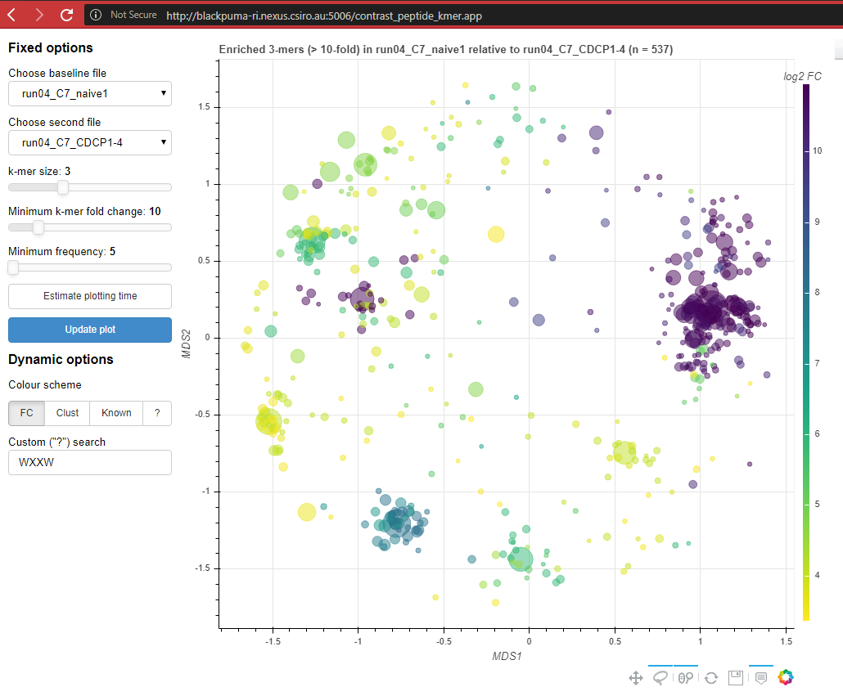
My day-to-day stuff
I make pretty pictures to identify patterns in the data

Slide 13
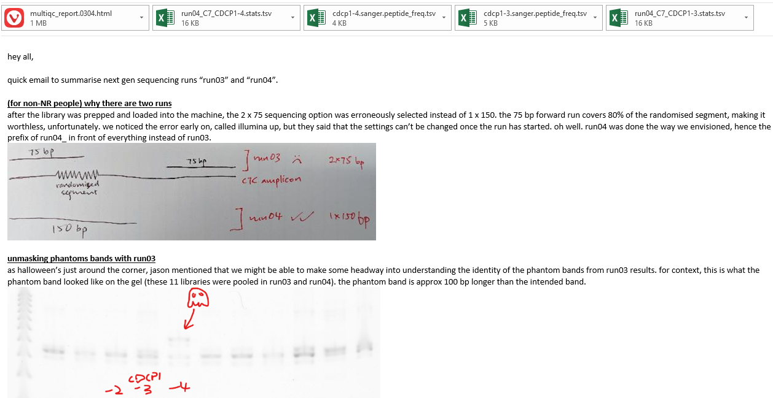
My day-to-day stuff
I write long-winded reports on my observations

Slide 14
What’s needed to be a bioinformatician?
Knowledge: solid grounding in
Biology
Mathematics (!!!)
English (!!!!!)
Soft skills: like all other jobs, try to be good at
Interpersonal skills
Explaining stuff
Work hard
Above all, stay CURIOUS

Slide 15
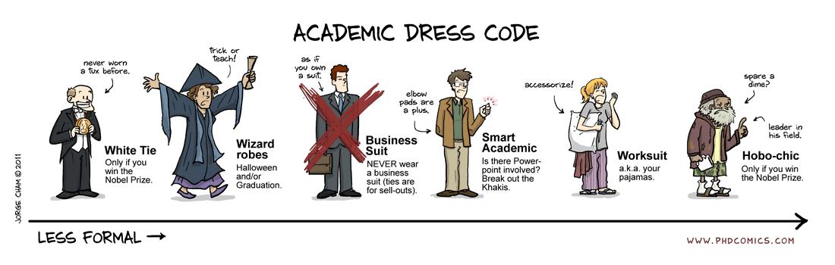
Hidden scientific perk

Slide 16
Main
Four course meal

Slide 17
Main course
DATA: the base of the dish
Importance of great ingredients
COMPUTING: processing the ingredients
Cut? Garotte? Slice?
MATHEMATICS: taste-tasting
Is it good, or SIGNIFICANTLY good?
BIOLOGY: presenting the dish
A5 Wagyu sucks, if customer wanted scrambled eggs

Slide 18
DATA

Slide 19
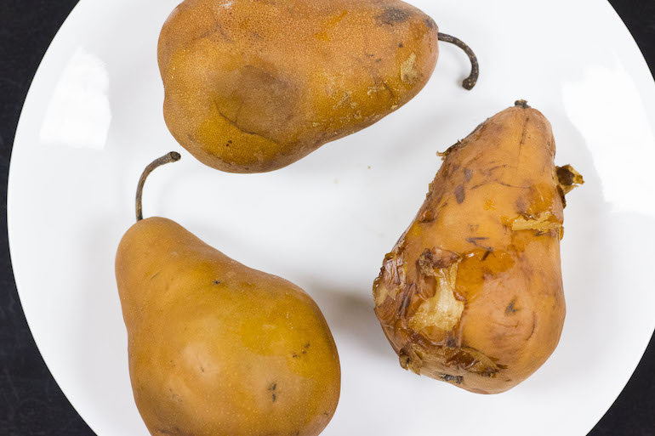
Garbage in, garbage out
Notes:
Heaps of $ spent on collecting good data. Ref Census 2021. Why spend so much money on it?

Slide 20
Data-driven hypotheses
Data
Hypothesis
Experiments
Notes:
Past research tend to start at hypothesis, nowadays start at data.

Slide 21
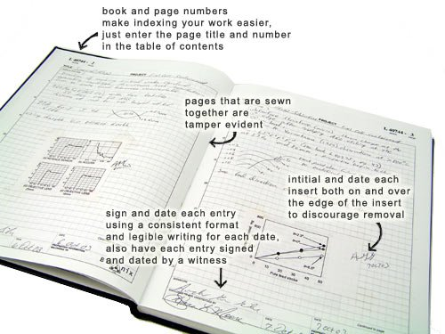
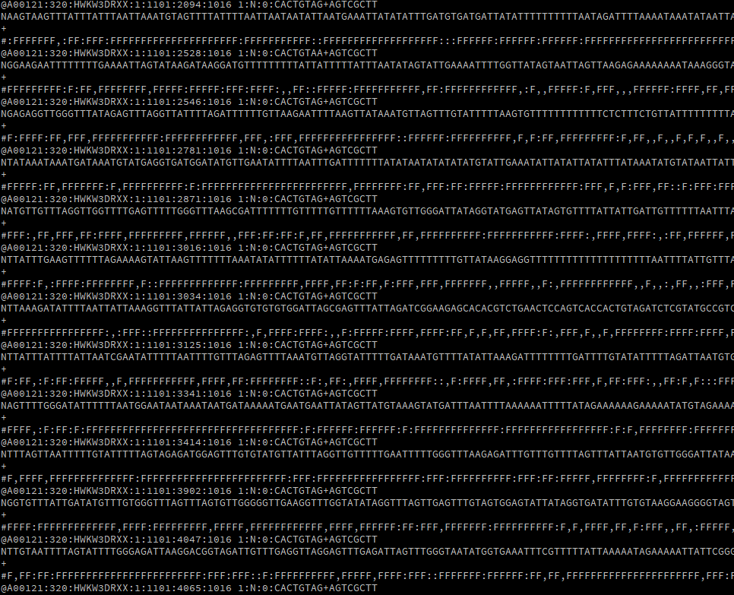
Data generated from experiments

Slide 22
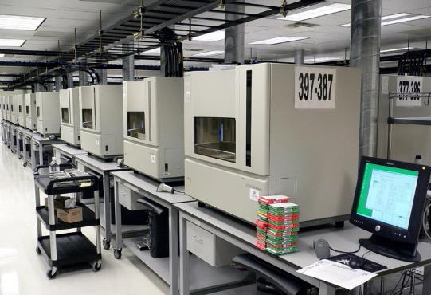
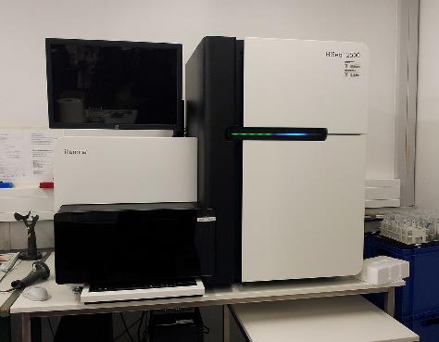
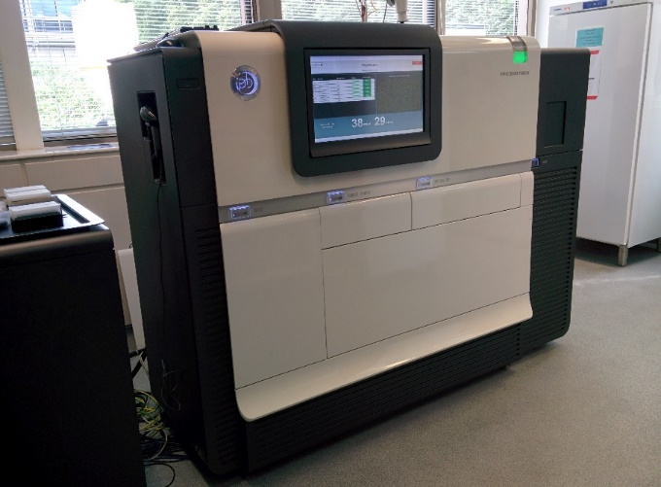
Case study: DNA sequencing
Sanger sequencer
Next-generation sequencing (Illumina / SOLiD / 454)
Single molecule sequencing (PacBio / ONT)

Slide 23
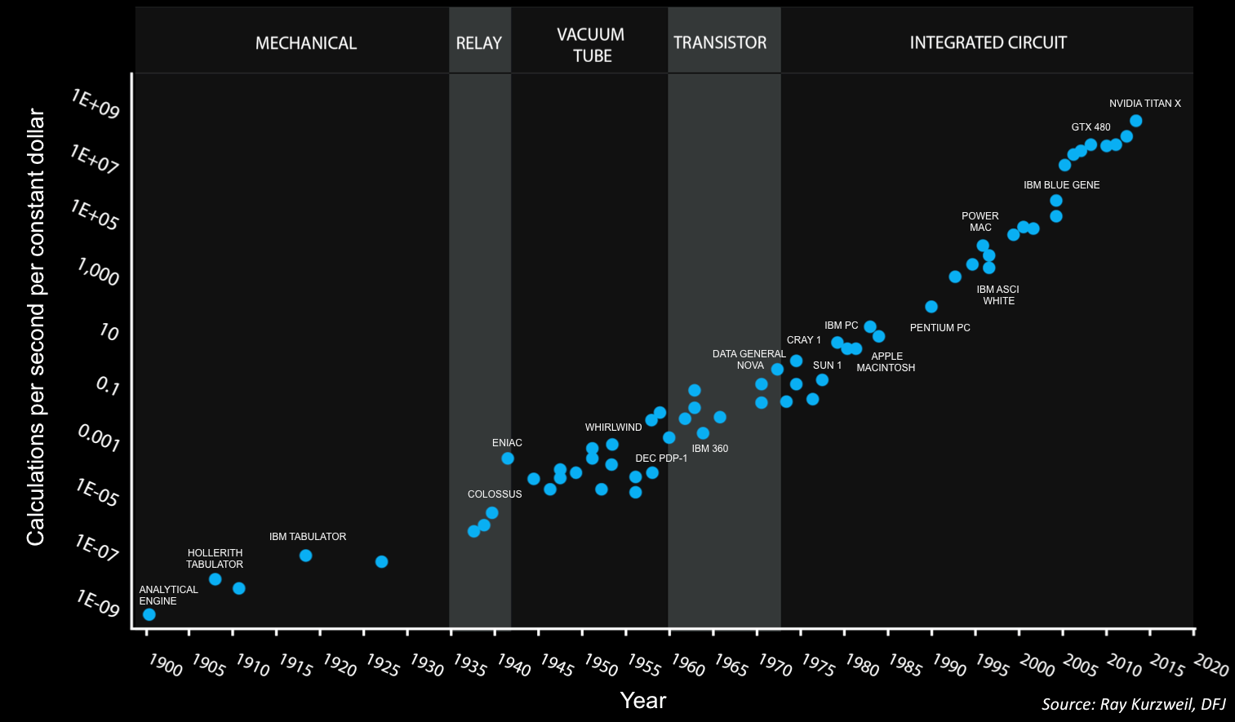
Case study: exponential growth in computing power

Slide 24
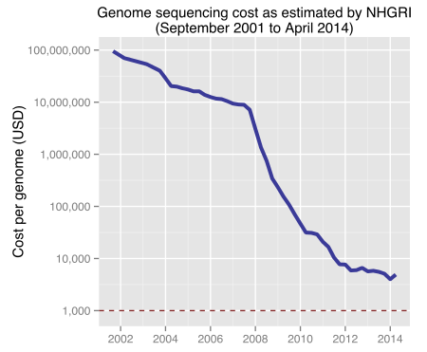
Case study: overall DNA sequencing cost

Slide 25
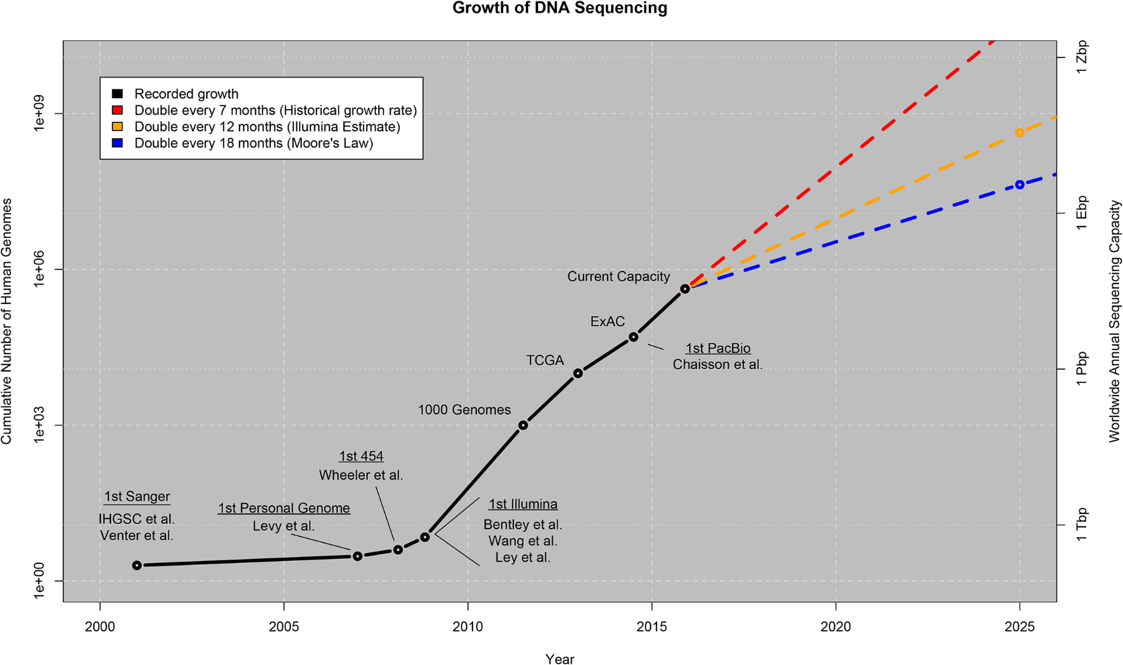
Case study: Explosive growth in DNA data

Slide 26
COMP

Slide 27
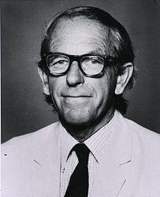
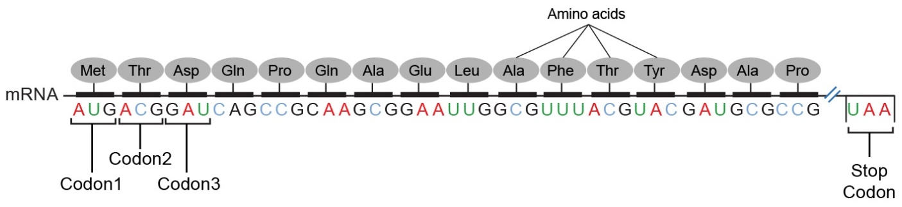
Bioinformatics (= computational biology)
Bioinformatics = biology + computing (informatics)
Earliest bioinformatics problems were:
Aligning protein sequences (protein sequencing pioneered 1950s)
Studying bacteriophage genomes (DNA sequencing pioneered 1970s), reinforced concepts of codons, open reading frames etc.
Fred Sanger (1918 – 2013)

Slide 28
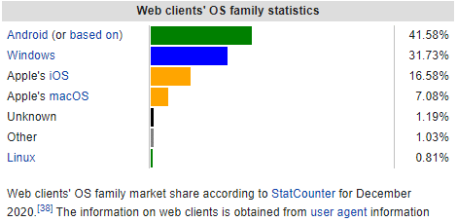
Modern bioinformatics run on Linux

Slide 29
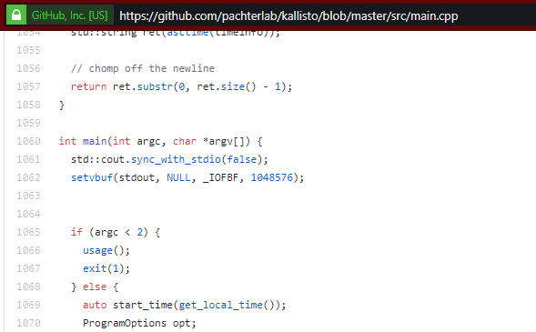
Bioinformaticians are the 1%
Bioinformatics programs are PREDOMINANTLY written for Linux
Why?
Openness: anyone can read source code of bioinformatics software

Slide 30
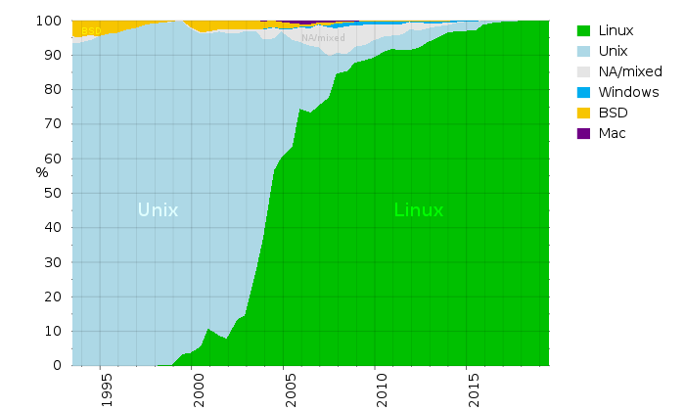
Bioinformaticians are the 1%
Bioinformatics programs are PREDOMINANTLY written for Linux
Why?
Supercomputers worldwide run Linux

Slide 31
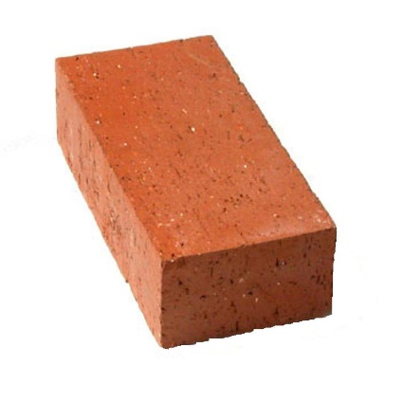
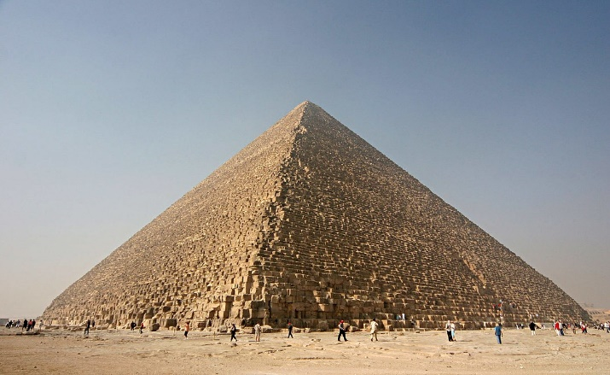
Bioinformaticians are the 1%
Bioinformatics programs are PREDOMINANTLY written for Linux
Why?
Ease at manipulating large files: nowadays, files > 1 GB are extremely common. Handling large files in Windows/OS X is extremely clunky!
Programming philosophy: modular vs monolithic
Linux
Windows/OS X

Slide 32
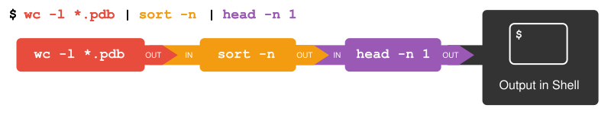
Bioinformaticians are the 1%
Bioinformatics programs are PREDOMINANTLY written for Linux
Why?
Text input/output, not silly proprietary filetypes (try opening a Word document in TextEdit/Notepad)
Piping: output of a tool can be “piped” as the input into another tool
When bioinformaticians put several programs together to produce the desired output, they say they’ve built a “pipeline”

Slide 33
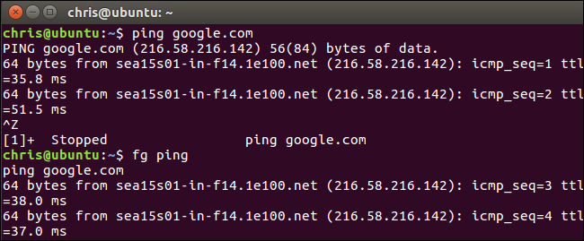
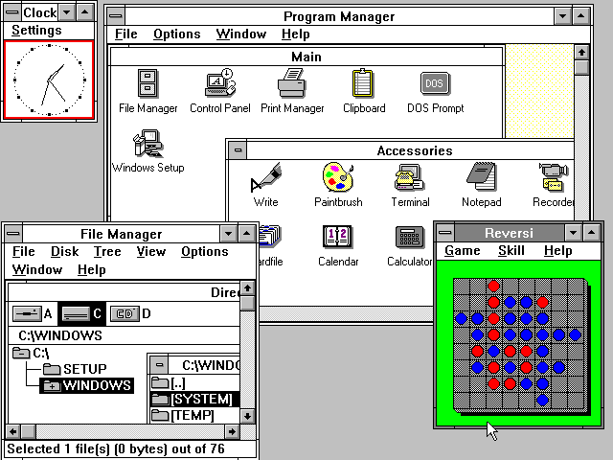
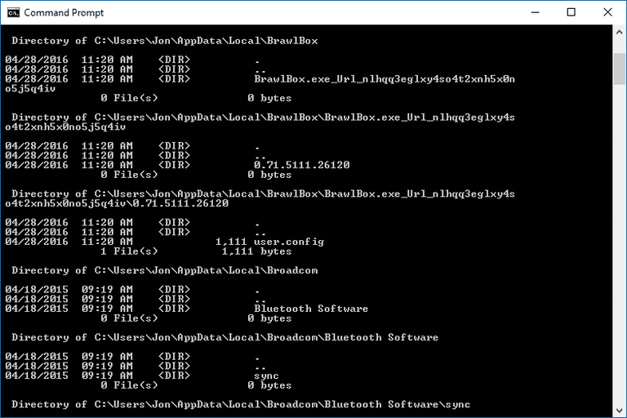
Heavy lifting done in command-line, not GUI

Slide 34
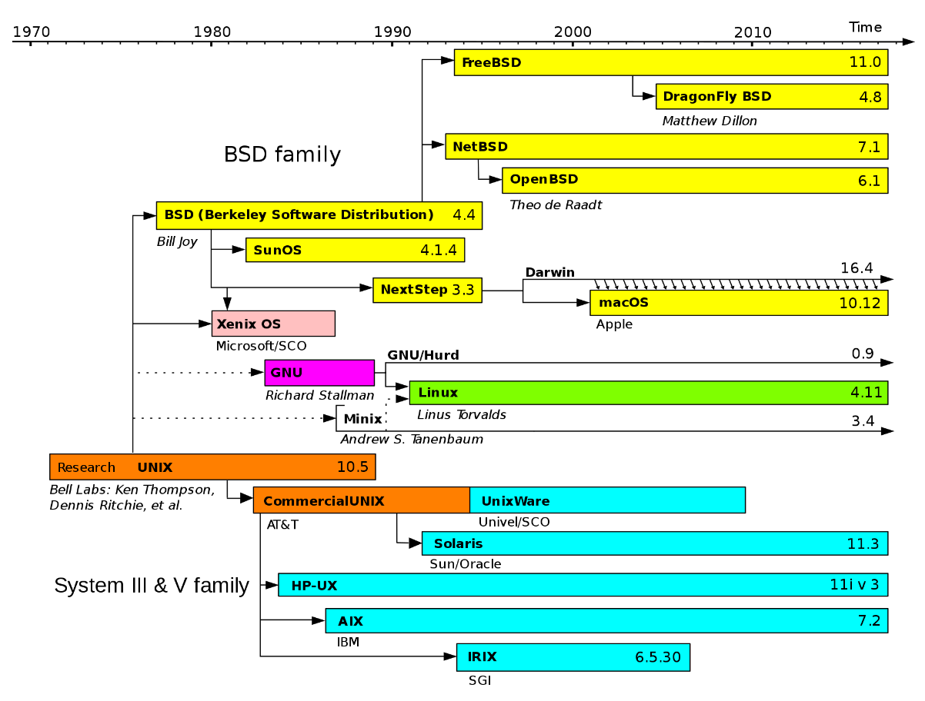
Command-lines are different!
OS X and Linux have similar command lines (arrows)
Windows command lines are very different
cmd: more UNIX-like
PowerShell: manipulates objects instead of text

Slide 35
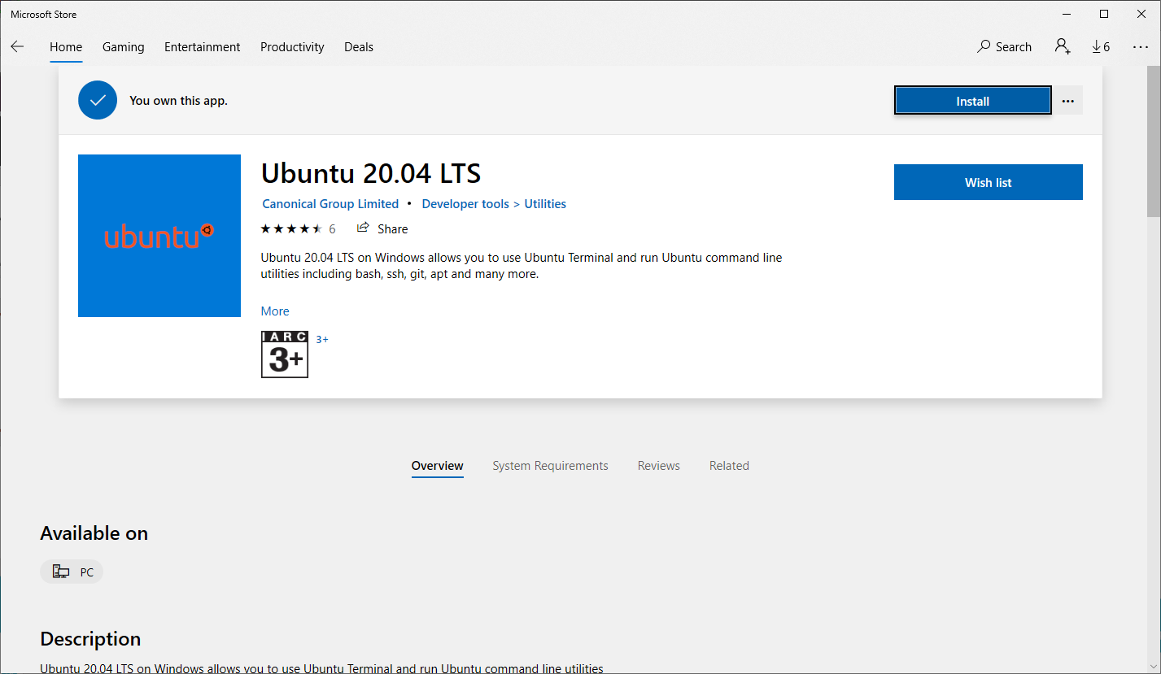
2016 onwards: Linux on Windows!

Slide 36
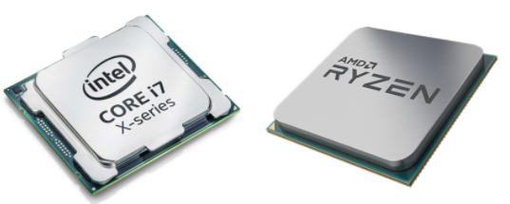
Low-level programming languages
Machine code
Processor-specific instructions read by microprocessors
8B542408 83FA0077 06B80000 0000C383
FA027706 B8010000 00C353BB 01000000
B9010000 008D0419 83FA0376 078BD98B
C84AEBF1
Assembly
Still processor-specific, BUT easier to write!
mov edx, [esp+8]
cmp edx, 0
ja @f
mov eax, 0
ret

Slide 37



High-level programming languages
Modern programming languages: ideas written in English, then “reverse translated” (compiled) back into machine code
Python
C
Assembly (x86-64 Linux)
print (“Hello, world!”)
printf (“Hello, world!\n”)
string: .ascii “Hello, world!\n” _start:
moveq $string, %rcx

Slide 38
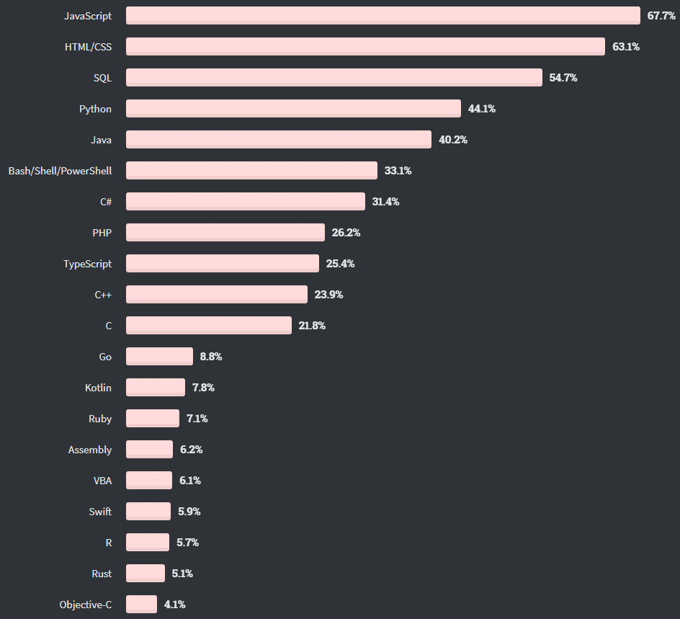
Which lang?
StackOverflow runs annual survey, 2020 results shown here
Highlighted are languages most relevant to bioinformatics
(learning more never hurts!)

Slide 39
MATH

Slide 40
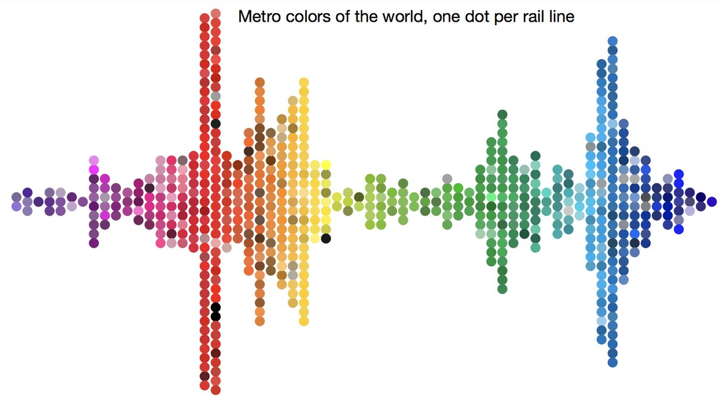
Statistics: why learn it?
Allows one to quantify whether data is interesting!

Slide 41
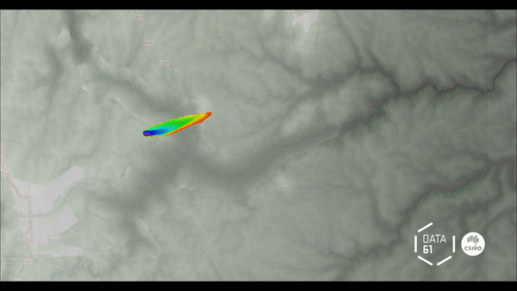
Statistics: basis of machine learning / AI
CSIRO’s Data61 models spread of bushfire with AI

Slide 42
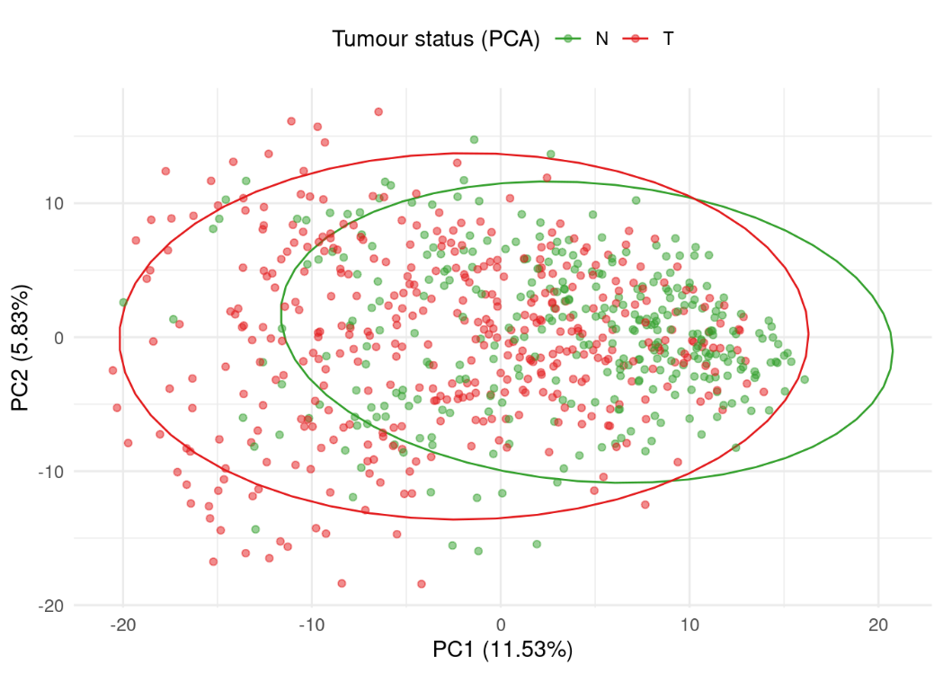
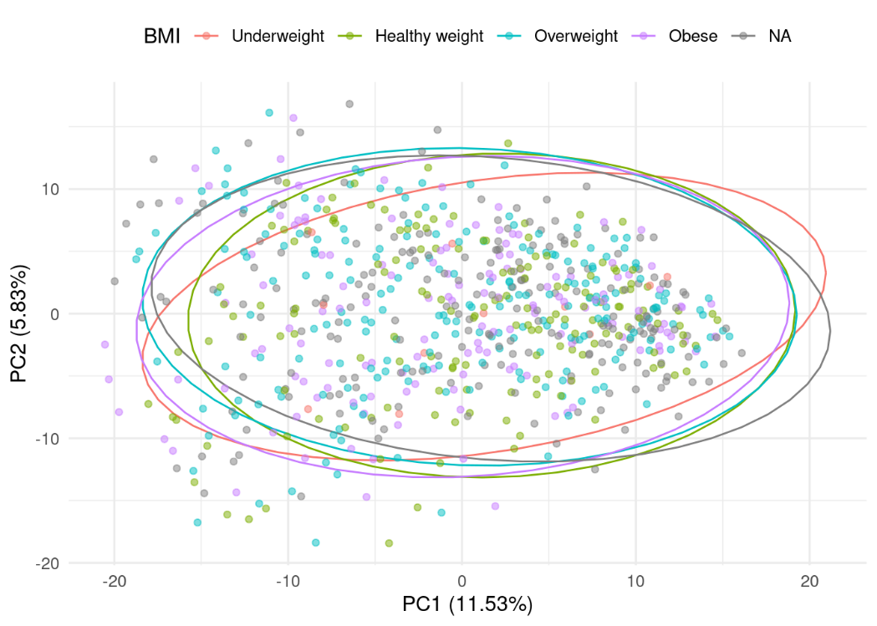
Examples from my work
Visualising microbiome patterns vs. tumour status, or vs. weight

Slide 43
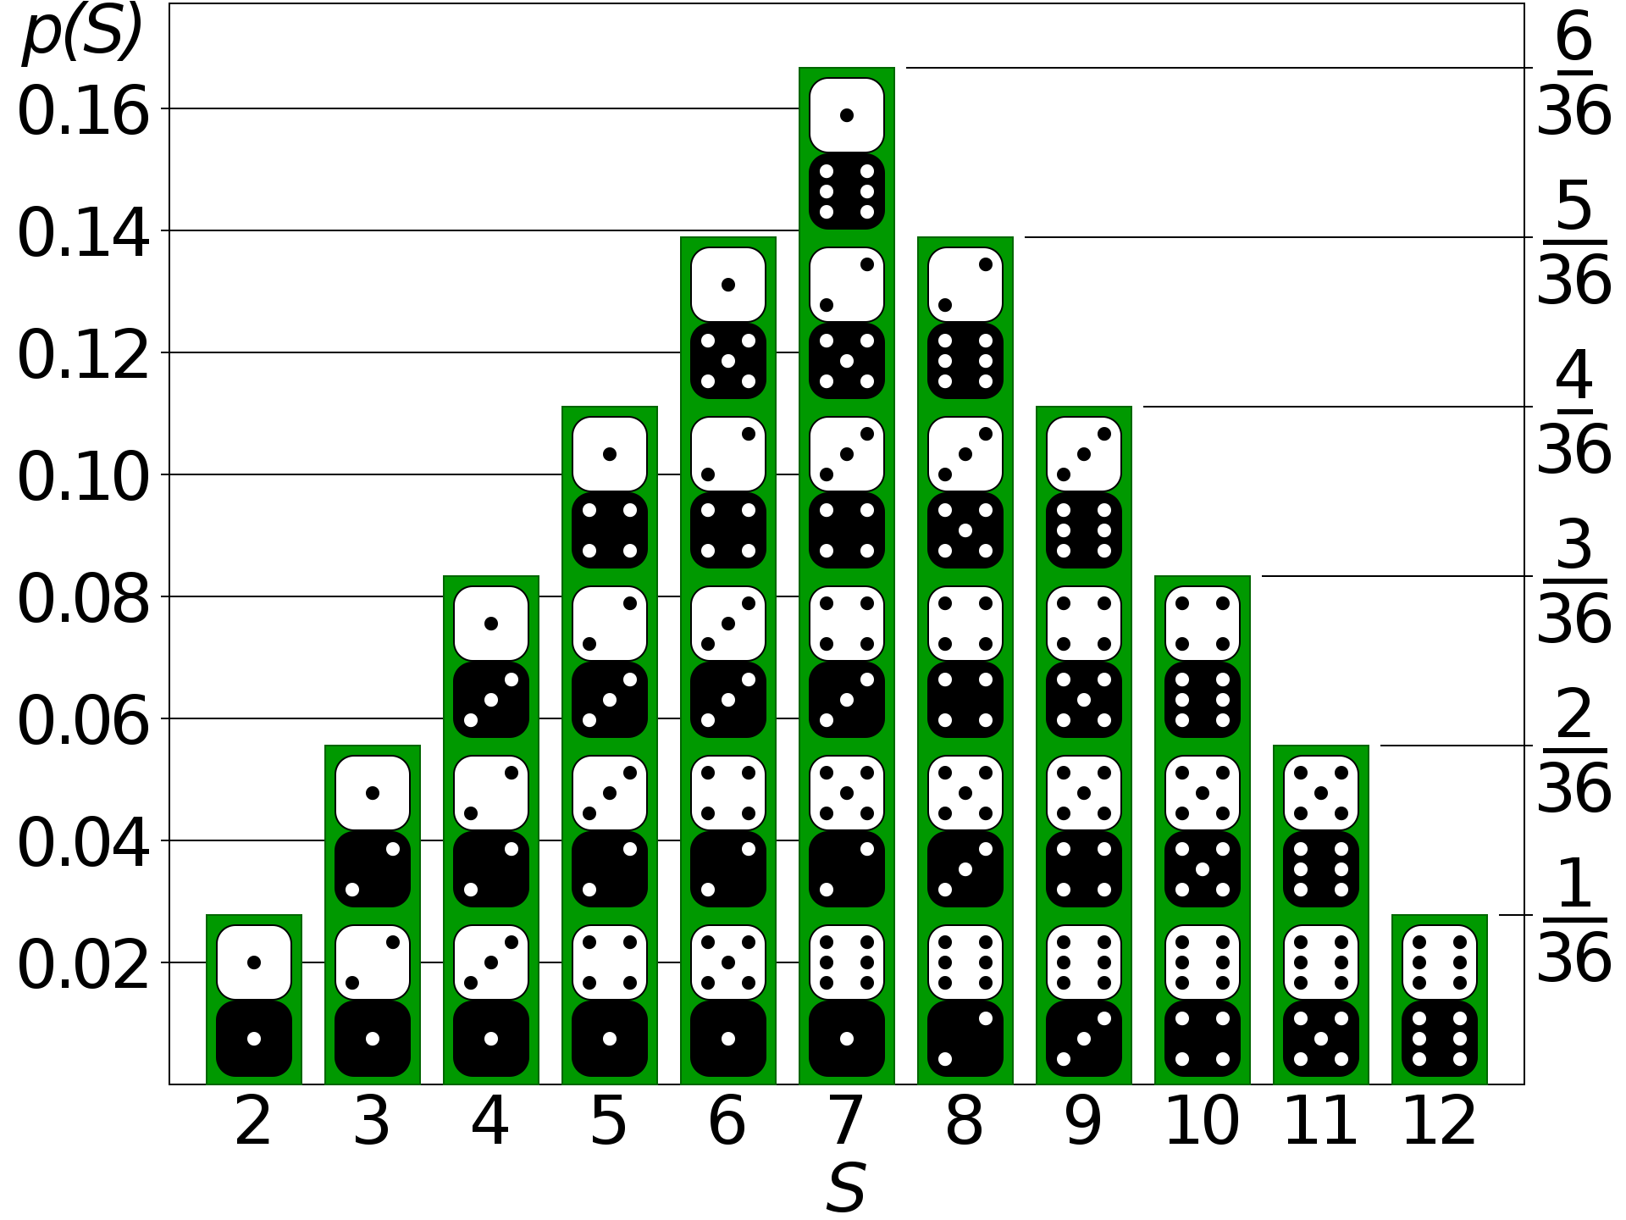
Statistics: understanding probabilities

Slide 44
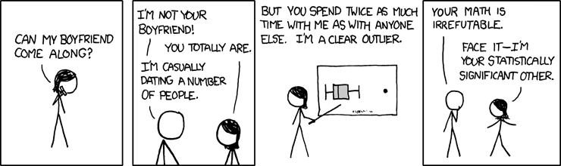
Statistical significance
“p < 0.05”: what do the p values mean?

Slide 45
Statistics: understanding probabilities
p = 0.05
statistical significance

Slide 46
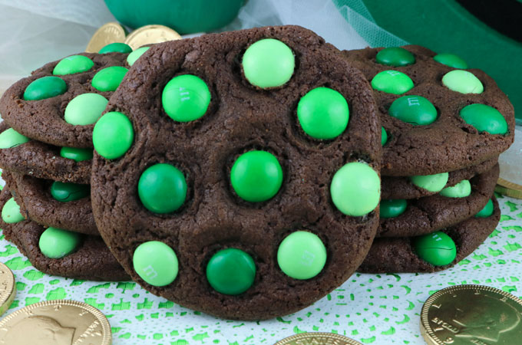
Fisher’s exact test
Is this observation statistically significant?

Slide 47
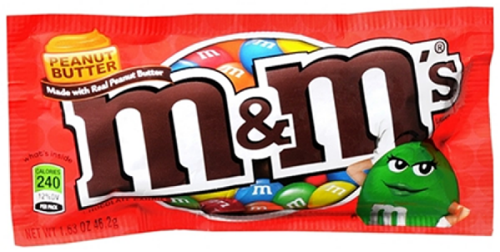

Fisher’s exact test
... depends on which bag of M&Ms you used!
p < 0.05
Statistically significant
p > 0.05
Statistically insignificant

Slide 48
Fisher’s exact test
For the heck of it, let’s calculate some p values:
M&M website says that pack has ~50 candies
There are 5 colours, R G Y B O
We expect 10 green per packet
Cookie has 10 green M&Ms
Set up Fisher’s exact table
 | Green M&M | Non-green M&M
Cookie | 10 | 0
Not-on-cookie | 0 | 40

Slide 49
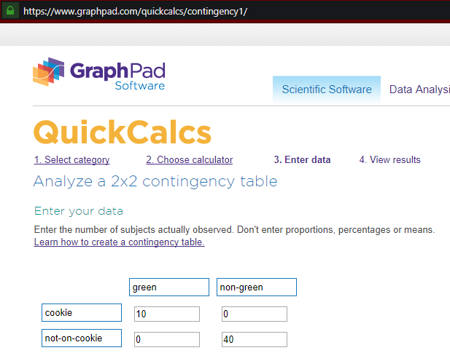
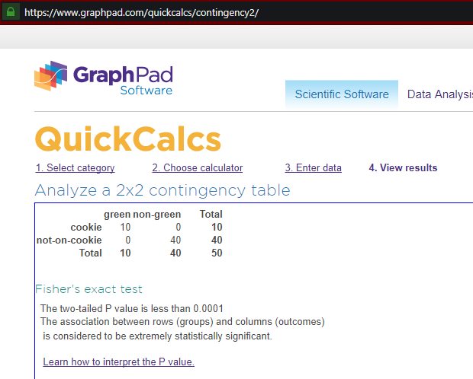
Fisher’s exact test

Slide 50
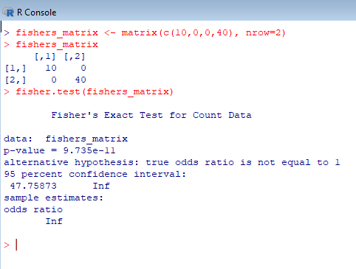
Fisher’s exact test
If we want precise p values, we can use R:

Slide 51
BIO

Slide 52
Fisher’s exact test, feat. biology
Let’s look at a more biological example
Perform a heat stress experiment
Obtain genes that were upregulated under stress
Check GO terms associated with these genes
p = 9.735 x 10⁻¹¹
p = 0.00000000009735 (In English, this is “statistically very significant”)
 | Genes with GO:0016209 | Genes without GO:0016209
Upregulated | 10 | 0
Not upregulated | 0 | 40

Slide 53
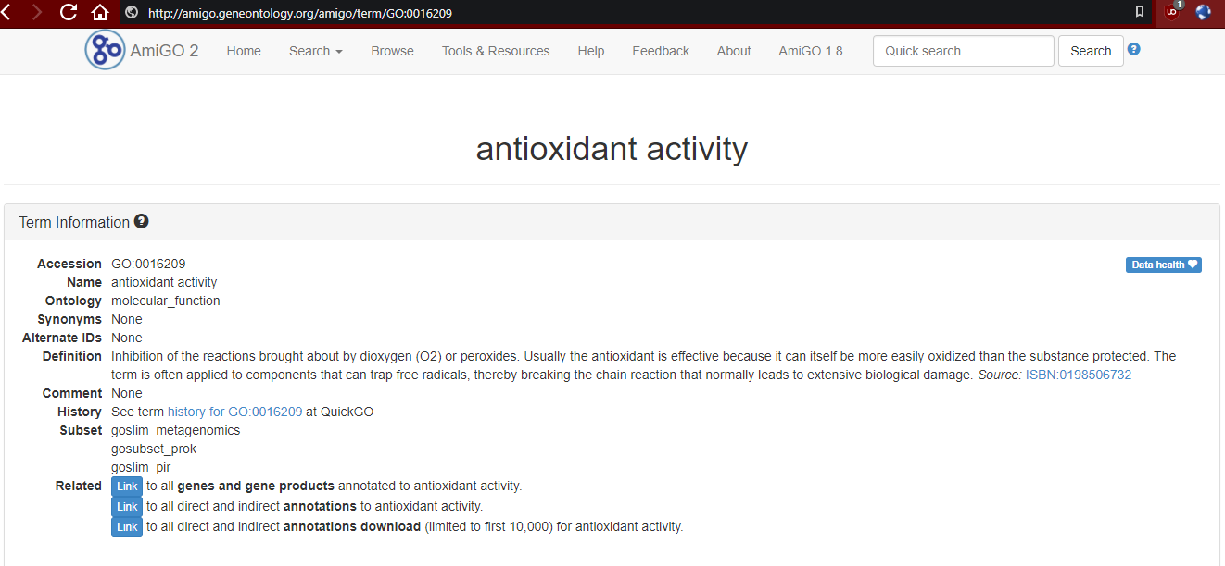
... GO:0016209?

Slide 54
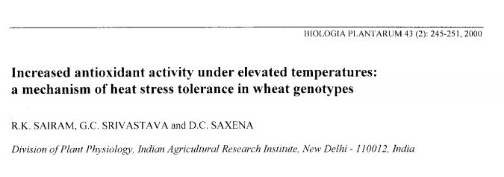
... GO:0016209?

Slide 55
Knowledge of bio gives context to datacompmath
Notes:
Salvages poor data, e.g. finding higher sugar content in decaying pears WAS SO TOTALLY PART OF WHAT WE SET OUT TO STUDY INITIALLY

Slide 56


Slide 57
Modern examples of bioinformatics
Sequence analysis
Sequence searches: infer function of unknown DNA sequence
Comparative genomics: infer evolutionary trees from conserved proteins
Evolutionary biology: detect gene duplication / horizontal gene transfer
Mutational analysis: detect predisposition to diseases via SNP patterns
Expression studies
Microarrays / RNA-seq: detect upregulated or downregulated genes
Protein mass spectrometry: deduce function, quantify expression
Structural studies
Protein X-ray crystallography: calculate most likely structure of enzymes

Slide 58
Modern examples of bioinformatics
Systems biology
“Interactome”: deduce key proteins from map of protein interactions
Pathway analysis: deduce presence/absence of conserved pathways in new genomes
Image analysis
Track movement of cells, flies, fish, humans…
Data mining
IBM’s “Watson” supercomputer chomps thru medical literature, helps provide diagnosis and detect whether drug combinations have bad side effects

Slide 59
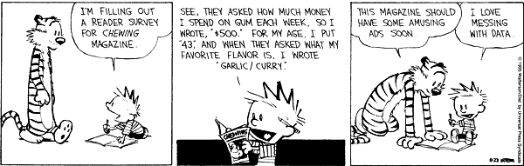
Dessert
Questions / Demo / Freestyle

Slide 60
Thank you
Health and Biosecurity
Yi Jin Liew Research Scientist
yijin.liew@csiro.au

